Slide 1
Let's play with Python
Ramesh S

Slide 2
What is Python?
Python is a high
level programming language

Slide 3
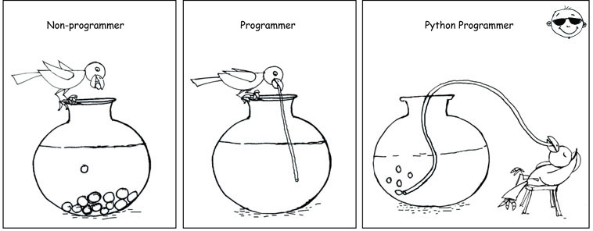

Slide 4
What is Python?
Python is a
general purpose programming language

Slide 5
What is Python?
Python is
fun
powerful
fast

Slide 6
What is Python?
Python has
a huge
standard library

Slide 7
What is Python?
Python is
interpreted

Slide 8
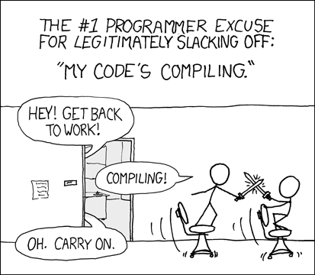
What developers do during compilation?

Slide 9
What is Python?
Python
is
dynamically typed

Slide 10
What is Python?
Python
is
object oriented

Slide 11




What is Python?
Python
is
portable

Slide 12

What is Python?
Python
is
open
source

Slide 13

Who created Python?
Guido van Rossum
Benevolent Dictator for Life (BDFL)
- Python Software Foundation.

Slide 14
When was python released?
1991

Slide 15
Who is using python?
  NASA
  Google
  Microsoft
  eBay
  PayPal
  Dropbox
  OpenStack

Slide 16
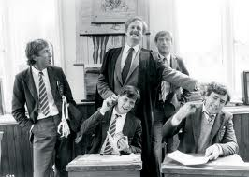
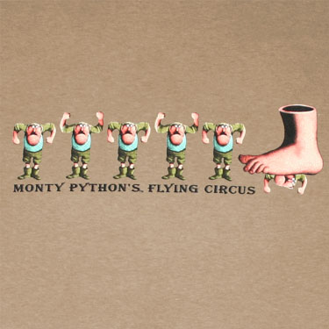
Why is it called python?
Monty Python Flying Circus

Slide 17
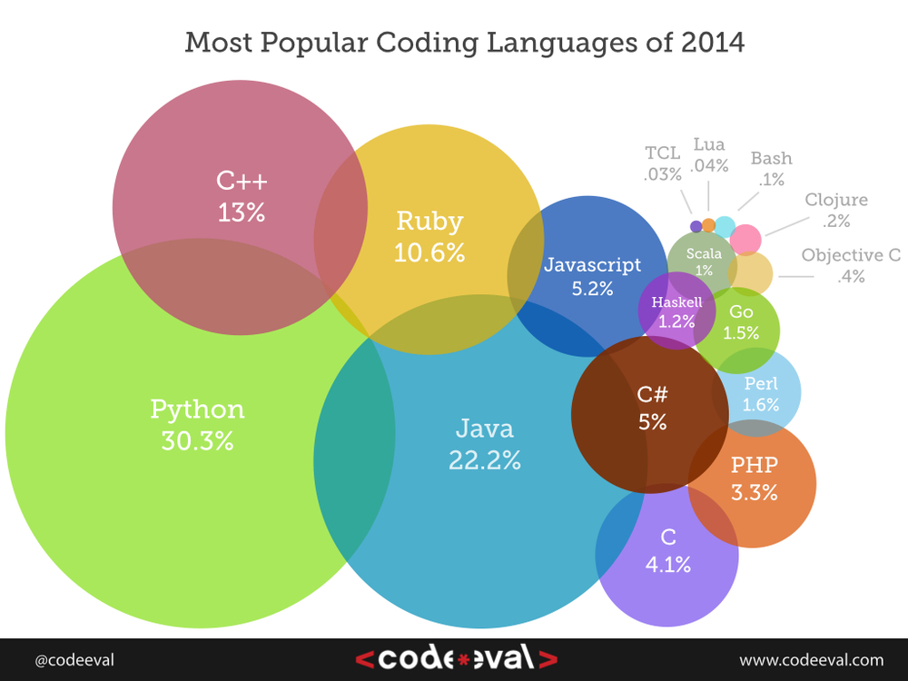
How popular is Python?

Slide 18
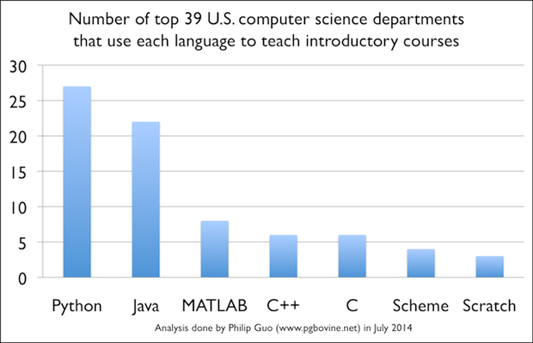
How popular is Python?

Slide 19
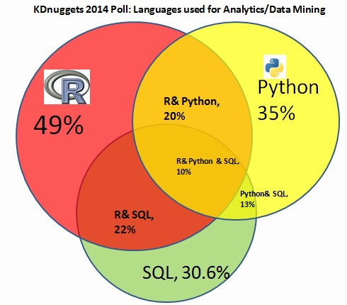
How popular is Python?

Slide 20
Where is Python used
Scripting
Rapid Prototyping
Text Processing
Web applications
GUI programs
Game Development
Database Applications
System Administration Automation
Scientific Computing
Machine Learning
BigData and Data Analysis

Slide 21
Learning Python is Easy - Check these out

Slide 22
Which version????
      2.x vs 3.x

Slide 23
What does this program do?
print "Hello World"

Slide 24
What does this program do?
count=0
while count<11:
print count
count+=1

Slide 25
What does this program do?
kids=['Lahari','Lalitha','Jithu','Vishal','Ujwal','Nitish']
for kid in kids:
print kid

Slide 26
What does this program do?
kids=['Lahari','Lalitha','Jithu','Vishal','Ujwal','Nitish']
for kid in kids:
if len(kid)==6:
print kid

Slide 27
What does this program do?
kids=['Lahari','Lalitha','Jithu','Vishal','Ujwal','Nitish']
for kid in kids:
if "it" in kid:
print kid

Slide 28
What does this program do?
marks={'maths':97,'science':'98','history':78}
for subject,marks in marks.items():
print subject,marks

Slide 29
What does this program do?
f=open('dictionary.txt','r')
for line in f:
if line.startswith('s'):
print line

Slide 30
What does this program do?
for x in range(5):
print(x)

Slide 31
What does this program do?
for x in range(5,10):
print(x)

Slide 32
What does this program do?
for x in range(5,100,5):
print(x)

Slide 33
What does this program do?
f=open('words.txt','r')
j=open('new-words.txt','w')
j.write(f.read())
f.close()
j.close()

Slide 34
What does this program do?
def factorial(n):
fact=1
for x in range(n,1,-1):
fact*=x
return fact
print factorial(4)

Slide 35
What does this program do?
squares=[]
for x in range(1,100):
squares.append(x*x)
print squares

Slide 36
Playing with strings
print( "Hello World")
name=raw_input("Please enter your name:")
print( "Hello", name)
print(len(name))
print(type(name))
print(name[0])
print(name[-1])
print(name[0:3])
print(name[3:])
print(name[:4])

Slide 37
Playing with strings
print name[0:10:2]
print name[::1]
print name[::-1]
print name[:]
print name.lower()
print name.upper()
print name.capitalize()
print name.swapcase()

Slide 38
Playing with strings
var='c'
var1="India"
_var="""This is
a multi line
string."""
print type(var)
print type(var1)
print type(_var)

Slide 39
Playing with strings
a='hello'
print a + a
print a + “hi”
print a * 5

Slide 40
Comments
Use # for single line comments
Use """ for multiline comments
#this is a single line comment
"""this is a
multiline
comment
"""

Slide 41
Playing with numbers
a,b,c=10,3,3.0
print a/b
print a/c
print a//c
print a%b
print a**b
print abs(b-a)

Slide 42
Playing with booleans
a,b=True,False
print a
print type(b)
print a and b
print a or b
print not b
print a and not b
print (4>6) and (7<3)
print (3==3.0) and (7<10)

Slide 43
Playing with lists
List is like an array in C, but far more flexible.
a=[1,5,8,3,5,9,7]
print type(a)
print a[0]
print a[-1]
print len(a)
print sum(a)
print min(a)
print max(a)
print a[2:5]
print a[::2]

Slide 44
Playing with lists
a=[1,5,8,3,5,9,7]
a.append(9)
print a
a.insert(1,200)
print a
print a.index(5)
print a.count(5)
a.sort()
print a
a.reverse()
print a

Slide 45
Playing with lists
print a
a.remove(9)
print a
c=a.pop()
print c
print a
a.extend([7,8,9])
print a

Slide 46
List Exercises
create a list of strings
sort it
print the last 4 strings
create a list of numbers(integers and floats)
remove the smallest one
find out if 9 is there in the list

Slide 47
Playing with tuples
A tuple is a read only list.
a=(1,5,8,3,5,9,7)
print type(a)
print a[0]
print a[-1]
print len(a)
print sum(a)
print min(a)
print max(a)
print a[2:5]
print a[::2]

Slide 48
Playing with tuples
b=3,4,5
print type(b)
print b.count(4)
print b.index(3)
print b[2]
b[2]=45
b.append(3)
b.sort()

Slide 49
Playing with dictionaries
d={'H':'Hydrogen','O':'Oxygen'}
print type(d)
print d.keys()
print d.values()
print d.items()
print d['H']
print d.get('H')
d['C']='Carbon'
print d
del d['H']
print d

Slide 50
Printing
print("Hello World")
print("Hello", "India")
print( "{} is a {}".format('Water','Liquid'))
print "Avg height of Indian men is %f" % 1.62
print "Avg height of Indian men is %d" % 1.62
print "Avg height of Indian men is %s" % 1.62

Slide 51
Data Types
a=None
b=True
c=45
d=56.3
e="hello"
f=[]
g=3,4,5
h={"a":"apple","b":"Bat"}
i={5,4,3,9}

Slide 52
type casting
a=3
print(float(a))
type cast a str into list
type cast a dict into list
type cast a tuple into list
type cast a list into set
type cast a list into dict

Slide 53
Advanced assignments
>>> a=b=c=2
>>> print a,b,c
>>> a,b,c=2,3,4
>>> print a,b,c
>>> a=[4,5,6]
>>> x,y,z=a
>>> print x,y,z
>>> x,y=a
>>> w,x,y,z=a

Slide 54
Swapping
>>> a=10
>>> b=5
>>> a,b=b,a
>>> print a
>>> print b

Slide 55
Conditional - if
aura = 2
if aura < 2.5:
print "you are not healthy"

Slide 56
Conditional - if - else
aura = 2
if aura <= 1:
print( "You're dead!" )
else:
print( "You're alive!" )

Slide 57
Conditional -if-elif-else
aura = 2
if aura <= 1:
print "You're dead!"
elif aura > 3:
print "You're spiritual!"
else:
print "You're alive!"

Slide 58
Looping-for
weapons = ["Arrow", "Mace", "Spear", "Sword"]
for x in weapons:
print(x)
for weapon in weapons:
print(weapon)
print len(weapon)

Slide 59
Looping with range
for x in range(5):
print(x)
for x in range(5,15):
print(x)
for x in range(0,20,3):
print(x)

Slide 60
Looping with while
a=0
while a<10:
print(a)
a=a+1
# a++ and a-- are not valid
# you may use a+=1 or a-=1

Slide 61
Exercise
Create a list of squares of all odd numbers below 50 and print the list.

Slide 62
Exercise
a=[]
for x in range(1,50,2):
a.append(x*x)
print a

Slide 63
Simple function
def hello():
print("I am a simple function")
hello()

Slide 64
Function with arguments
def add(x,y):
return x+y
c=add(4,5)
print(c)
print(add(5,6))

Slide 65
Function assignment
Write a function diff which takes two
parameters and returns their difference.
ex:
diff(5,2) should return 3
diff(2,5) should return 3
Do not use abs() inside your function

Slide 66
def diff(a,b):
if a>b:
return a-b
else:
return b-a
def diff(a,b):
      if b > a:
      a,b=b,a
return a-b

Slide 67
Function with arguments with default values
def add(x,y=10):
return x+y
c=add(4,5)
d=add(5)
print(c,d)
print(add(5,6),add(8))

Slide 68
Keyword-arguments
def wish(name,age):
print("Hello {} you are {} years old".format(name,age))
wish('India',67)
wish(67,'India')
wish(age=67,name='India')
#When calling a function using keyword arguments the
#order of arguments does not matter.

Slide 69
global
age=16
def grow():
print age
age=age+1
print age
grow()
print age

Slide 70
global
age=16
def grow():
global age
print age
age=age+1
print age
grow()
print age

Slide 71
Function that returns multiple values
#python functions can return any number of
#values.
def sumdiff(a,b):
return a+b,abs(a-b)
print type(sumdiff(4,9))
mysum,mydiff=sumdiff(4,9)
print(mysum,mydiff)

Slide 72
Handling variable length arguments
def average(*num):
print(type(num))
print(num)
print(float(sum(num))/len(num))
average(3,4)
average(3,4,8)
average(3,4,8,90,4.5,5.3,7.8)
#*args will pack all the arguments into a tuple
#called args

Slide 73
Handling variable length arguments
def average(a,b,*num):
print(type(num))
print(num)
print((a+b+sum(num))/(2+len(num)))
average(3,4)
average(3,4,8)
average(3,4,8,90,4.5,5.3,7.8)
average()
#*args will pack all the arguments into a tuple
#called args

Slide 74
Variable length keyword-arguments
def polygon(**kwds):
print type(kwds)
print kwds
polygon(width=10,length=20)
polygon(width=10,length=20,height=5)
polygon(width=10,length=20,height=5,units='cm')
#**kwds will pack all the arguments into a dict
#called kwds

Slide 75
Handling any type of arguments
def polygon(a,b,c,*sides,**options):
print(type(options))
print(type(sides))
print(a,b,c)
polygon(8,7,6,4,2,8,units='cm',compute='area')
#**kwds will pack all the arguments into a dict
#called kwds

Slide 76
lambda functions
add=lambda x,y:x+y
print(add(4,5))
#these are anonymous functions
#they work are inline functions

Slide 77
Let's revisit functions
def parrot(voltage, state='a stiff', action='voom', type='Norwegian Blue'):
print "-- This parrot wouldn't", action,
print "if you put", voltage, "volts through it."
print "-- Lovely plumage, the", type
print "-- It's", state, "!"
Which call is correct?
parrot(1000)
correct
parrot()
wrong - required argument missing
parrot(action = 'VOOOOOM', voltage = 1000000)
correct
parrot('a thousand', state = 'pushing up the daisies')
correct
parrot(actor='John Cleese')
wrong - unknown keyword
parrot('a million', 'bereft of life', 'jump')
correct
parrot(110, voltage=220)
wrong - duplicate value for argument
parrot(voltage=5.0, 'dead')
wrong - non-keyword argument following keyword

Slide 78
File I/O - common scenarios
Read file contents at once f=open('input.txt','r') print(f.read()) f.close() | Read all lines into a list f=open('input.txt','r') lines= f.readlines() print(lines) f.close()
Read file char by char f=open('input.txt','r') print(f.read(1)) print(f.read(1)) f.close() | Write into a new file f=open('input.txt','w') f.write("this is line one") f.close()
Read file line by line f=open('input.txt','r') print(f.readline()) print(f.readline()) f.close() | Append to an existing file f=open('input.txt','a') f.write("\nthis is a new line") f.close()

Slide 79
Modules
Generic import
Universal import
Function import
Function import with rename
default name space
dir
help

Slide 80
Sample Module
mymodule.py
name='python'
def add(a,b,c):
return a+b+c
def sub(a,b):
return a-b

Slide 81
Sample Module
mymodule.py
name='python'
def add(a,b,c):
return a+b+c
def sub(a,b):
return a-b
myprogram.py
from mymodule import *
print name
print add(2,3,4)
print sub(7,3)

Slide 82
Sample Module
mymodule.py
name='python'
def add(a,b,c):
return a+b+c
def sub(a,b):
return a-b
print __name__
myprogram.py
from mymodule import *
print name
print add(2,3,4)
print sub(7,3)

Slide 83
Sample Module
mymodule.py
name='python'
def add(a,b,c):
return a+b+c
def sub(a,b):
return a-b
print __name__
myprogram.py
from mymodule import *
print name
print add(2,3,4)
print sub(7,3)
print __name__

Slide 84
Sample Module
mymodule.py
name='python'
def add(a,b,c):
return a+b+c
def sub(a,b):
return a-b
myprogram.py
from mymodule import *
def main():
  print name
  print add(2,3,4)
  print sub(7,3)
if __name__=='__main__':
main()

Slide 85
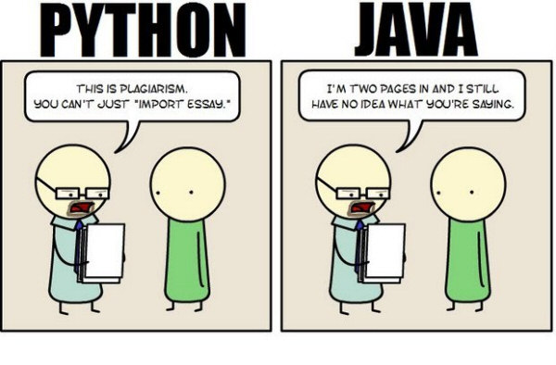
Writing an essay

Slide 86
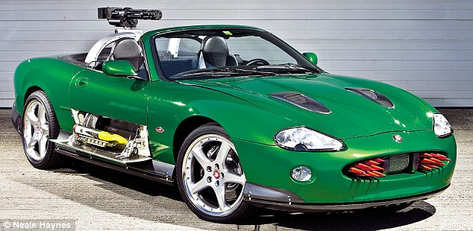

Slide 87
